Slide 1
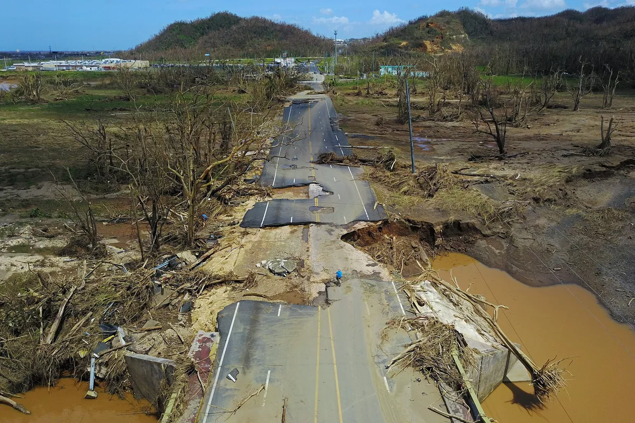
Recovery on the islands of the Caribbean after the havoc wrought by Hurricane Maria is still pressing
and very challenging.
The devastation is so great,
even three months later.
The general rule of thumb on domestic disasters is that recovery lasts 10 times longer than the relief phase.
The recovery in Puerto Rico will rewrite that formula.

Slide 2
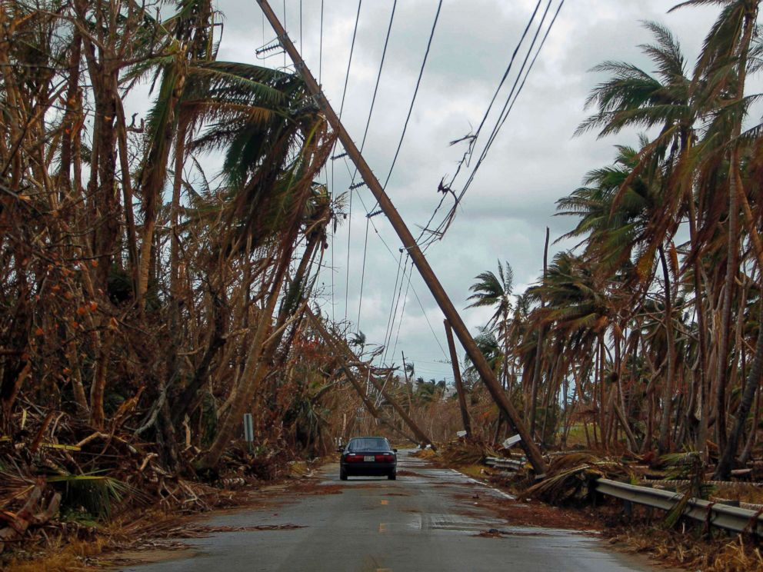
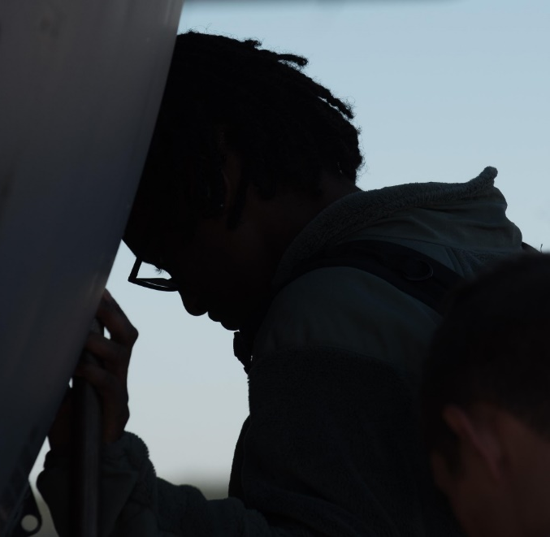
Barely half of the island of Puerto Rico has power, potable water is still lacking, and roads, bridges and buildings, including homes, hospitals, schools and churches remain destroyed.
Every single congregation
was affected by the hurricane,
many of them flooded, losing hymnals,
bibles, musical instruments,
sound systems and liturgical vestments.
Physical and emotional isolation across
the island among the people is all too real,
and the support, comfort, strength
and faith that comes from their church
homes is needed now, more than ever.

Slide 3
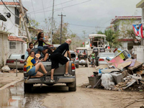
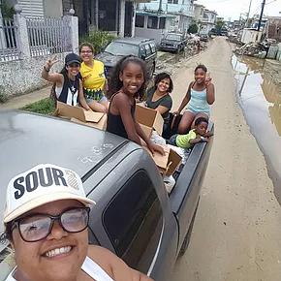
Yet there is hope!
In Toa Baja, where the river La Plata overflowed and flooded every home and church, church members and friends go out delivering supplies and coordinate many young-adult-led community service events.
Pastors persist and are living out their call as ministers of the gospel for their church and their beloved community.
And Lutheran Disaster Relief (LDR) has been on the ground working with San Pedro Lutheran Church and other churches on the island to provide food, water, and essentials to residents who have lost everything.

Slide 4
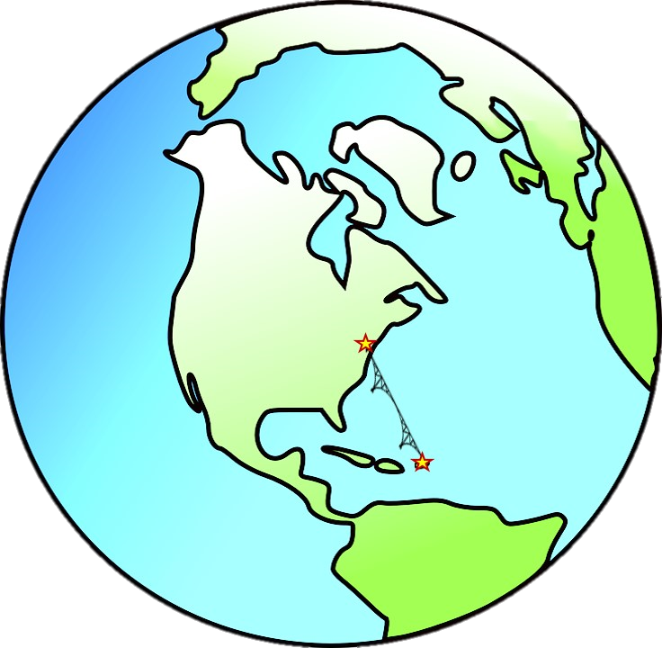
And here at home, we are doing something:
We’re
“Building Puentes” means building bridges.
It’s a joint ministry between the ELCA Caribbean Synod,
congregations, and the ELCA Metro D.C. Synod

Slide 5
During the season of Epiphany
we celebrate the light of the world
that has broken through the darkness
of our lives and our world.
And so, on Epiphany Sunday
all the congregations of the Metro D.C. Synod
were invited to lift up a special offering
to support our newly commissioned mission table:
“Building Puentes”
It’s just the beginning!

Slide 6
We will build connections and true relationship.
We will help in relief efforts
that not only rebuild concrete structures,
but will also rebuild the spirit of our neighbors, friends,
and fellow citizens of the Caribbean.
We’ll organize work trips and develop new and organic ways to connect and live into our mutual call
to follow the light no darkness can overcome.
This we can do together, in Jesus’ name.

Slide 7
“The brightest star on Puerto Rico’s horizon
is the presence and the promise of the Church.
I pray that star retains its brightness
in the months and years and decades ahead.”
Vaya con Dios (God be with you),
Melissa Marcia
Building Puentes Chairwoman

